Slide 2
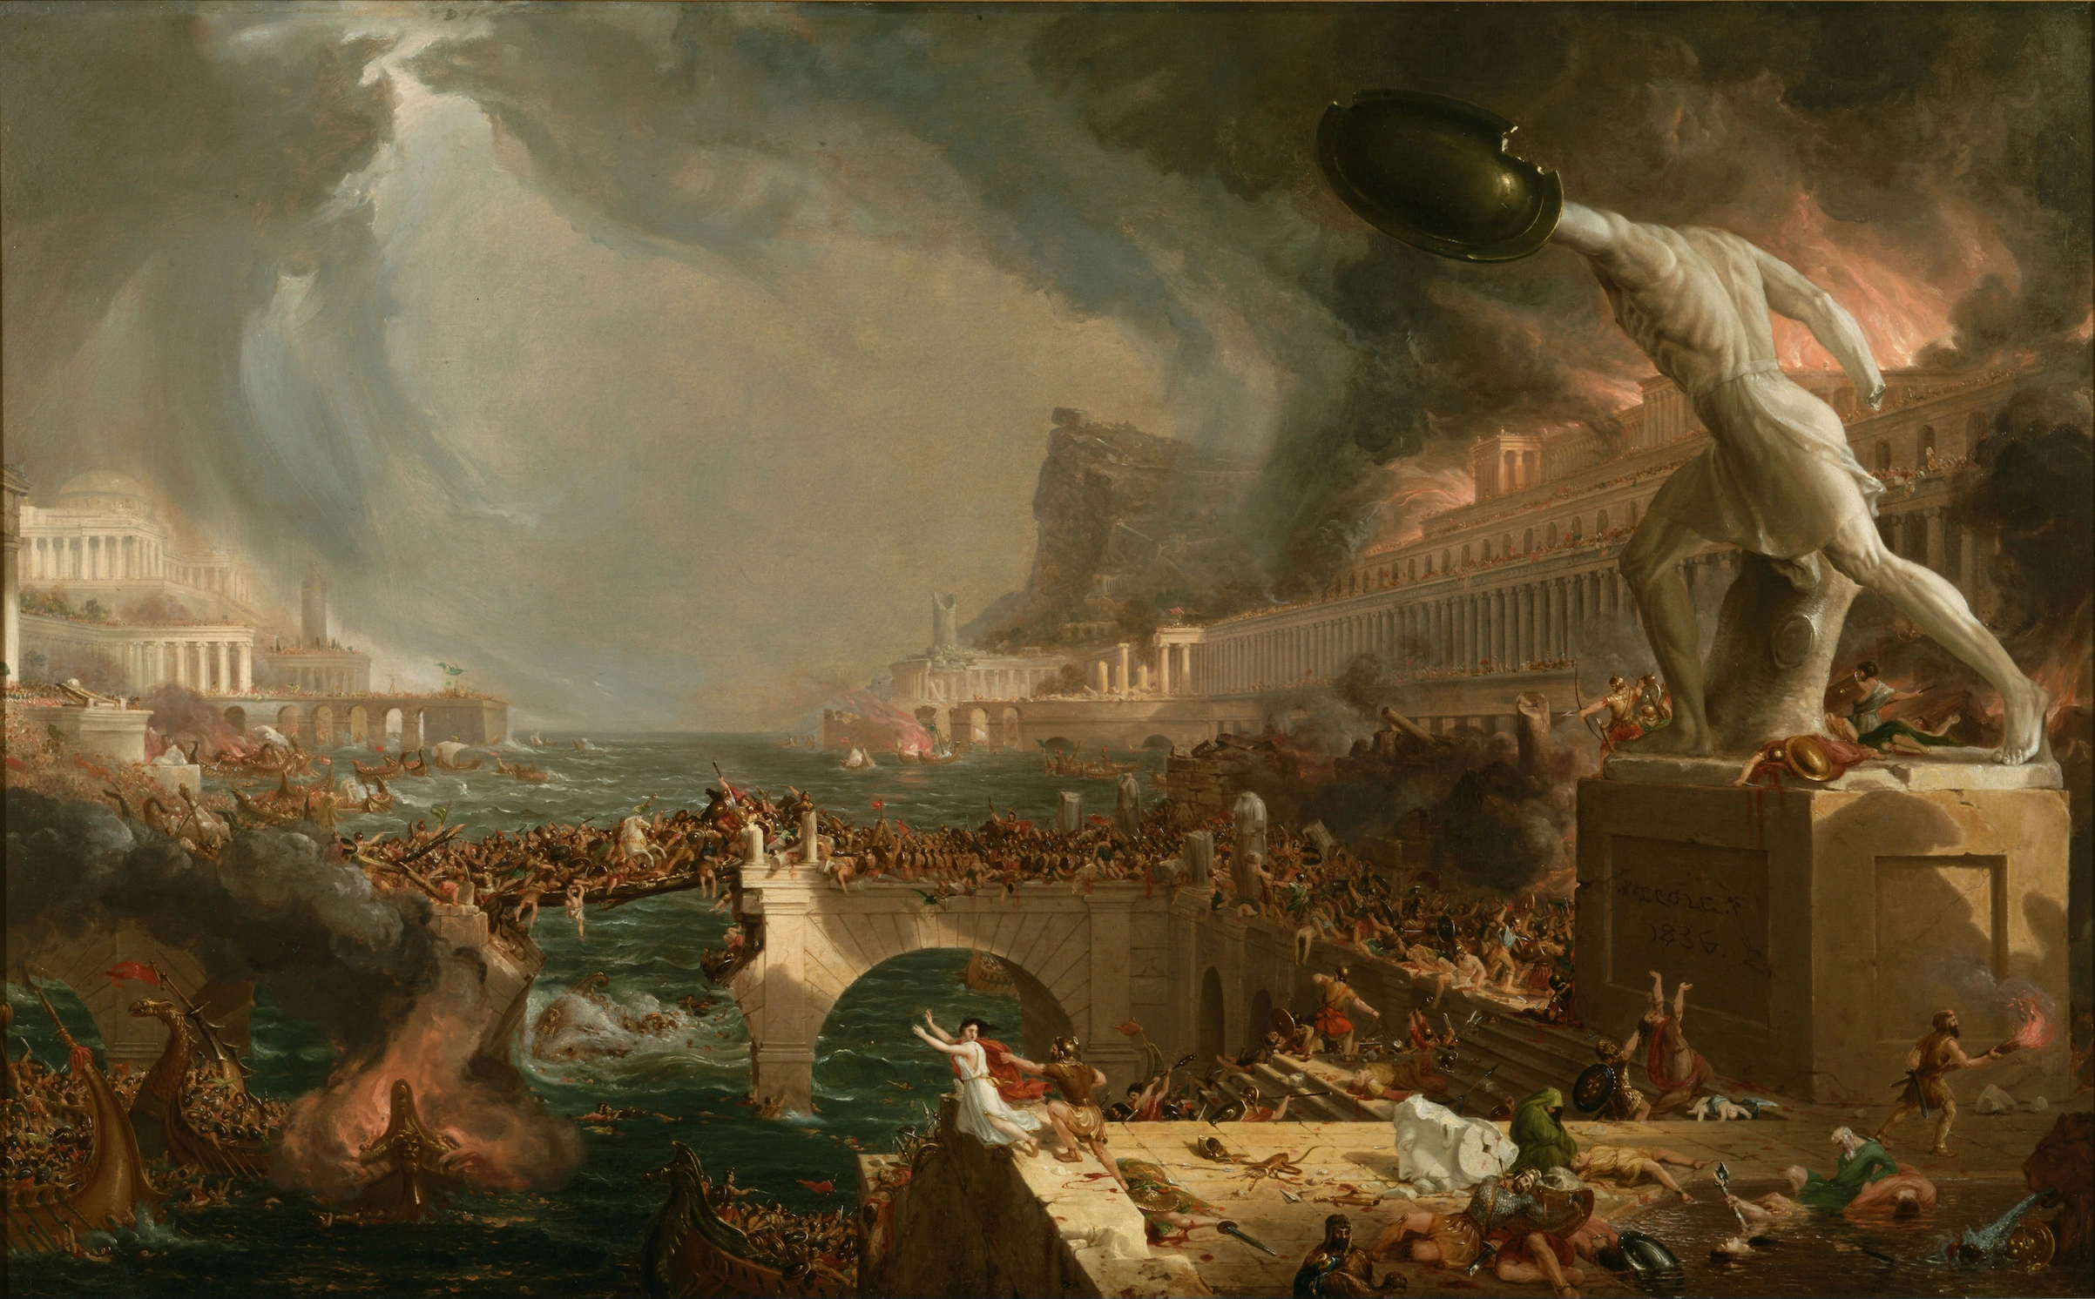

Slide 3


Slide 4

What is
Church Discipline

Slide 5
Project analysis slide 8
In This Study We Will Consider:
The New Testament Authority For Discipline
The Purpose For Church Discipline
Conduct Deserving Church Discipline
How The Final Act of Church Discipline Should Be Administered

Slide 6
Project analysis slide 8
NEW TESTAMENT AUTHORITY FOR CHURCH DISCIPLINE
Matthew 18:15-17 – Brother wrongs Brother and Will Not Repent
Romans 16:17 – Those who cause division are to be marked & avoided
1 Corinthians Chapter 5- “as does not exist even among the Gentiles..”

Slide 7
Project analysis slide 8
NEW TESTAMENT AUTHORITY FOR CHURCH DISCIPLINE
“taken away from among you” (v. 2)
“delivered unto Satan” (v.5)
“put away” (v. 13)
1 Corinthians 5:9-11 “not even to eat with such a person.”
2 Thessalonians 3:6 – A COMMAND
Titus 3:10 - “factious man,” or “heretic” is divisive

Slide 8
Project analysis slide 8
THE PURPOSE OF CHURCH DISCIPLINE
Not an act of REVENGE!
Never exercised in a haughty of a spiteful manner
Both corrective and protective
1 Corinthians 5:5 “that the spirit might be saved”
Matthew 18:15 – “gain” the wayward
2 Thessalonians 3:14 “ashamed”
Galatians 6:1 – “restored”
1 Corinthians 5:6 “a little leaven…”

Slide 9
Project analysis slide 8
THE PURPOSE OF CHURCH DISCIPLINE
Romans 16:17,18 “those who cause divisions and offenses, contrary to the doctrine which you learned, and avoid them”
1 Timothy 1:19,20 “delivered to Satan…”
2 Timothy 2:16-18 “have strayed concerning the truth”
1 Timothy 5:14 “give no opportunity to the adversary to speak reproachfully.”
1 Timothy 6:1 “ “the name of God and the doctrine be not blasphemed”
2 Peter 2:2 “way of truth be not evil spoken of”

Slide 10
Project analysis slide 8
CONDUCT DESERVING OF DISCIPLINE
Matthew 18:15-17 – One who has sinned against another but refuses to repent must be withdrawn from
Romans 16:17 – Those who cause occasions of stumbling, or division; Titus 3:10
Practitioners of fornication, covetousness, extortion, idolatry, drunkenness, and such like- 1 Corinthians 5:9-13
Advocates of soul-threatening doctrines must not continue in fellowship – 1 Timothy 1:19,20; 2 Timothy 2:16-18
Those who walk disorderly – 2 Thessalonians 3:6

Slide 11
Project analysis slide 8
HOW SHOULD FINAL ACT BE ADMINISTERED
If qualified men are serving as elders, they would lead.
However, it is NOT an “Elder act” – Entire church involved
1 Corinthians 5:4 “when you are gathered together”
Loving Discipline as much a trait of the New Testament church as correct worship, organization, etc.
“Can a church that utterly refuses to practice church discipline be a true New Testament church?”

